Slide 1
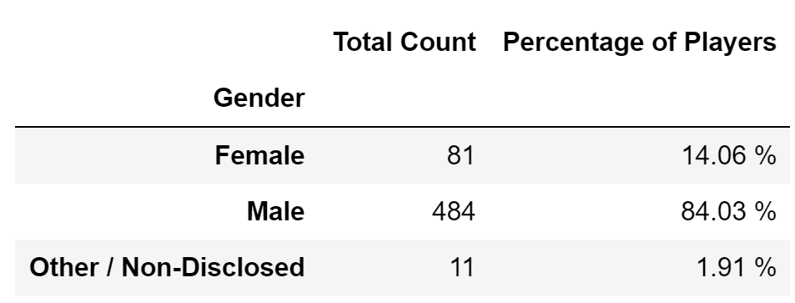

Observable Trends Based On Data
Not sure if I can reduce conclusions to ”three observable trends based on the data” but I will review one by one the most obvious ones that we can extract at every meaningful data analysis.
Conclusion 1. From ‘Gender Demographics’
The first and obvious conclusion is the fact that, for the analyzed sample, most buyers are “Male” with a huge specific weight of 84% compared to “Female” with 14% and a residual 1% for "Other/Non-disclosed"

Slide 2
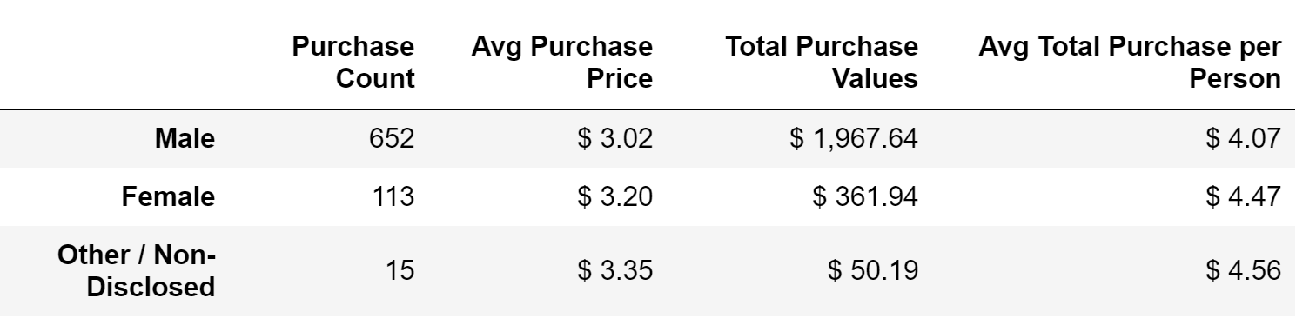
Conclusion 2. From ‘Purchasing Analysis (Gender)’
According to the analyzed sample, we can see that for every purchasing event, females spend approximately 10% more than males

Slide 3
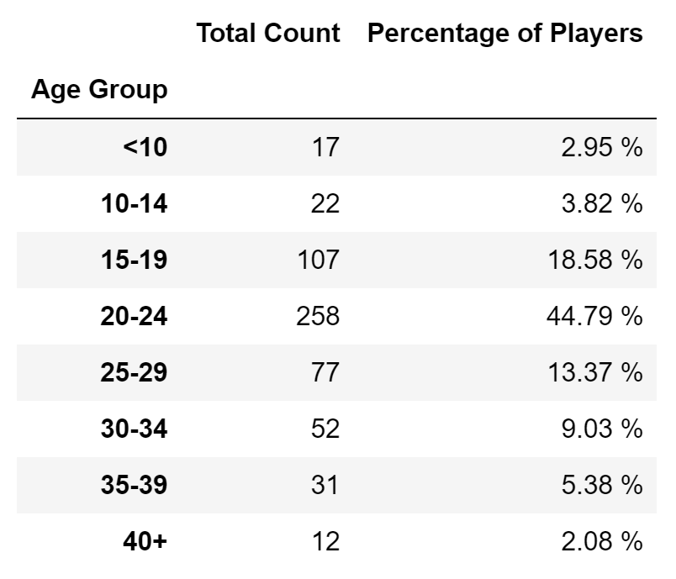
Conclusion 3. From ‘Age Demographics’
According to the analyzed sample, we can see that age group between 20 to 24 years old is the biggest shopper segment by a big margin, with a portion of sales of almost 45% of population.

Slide 4
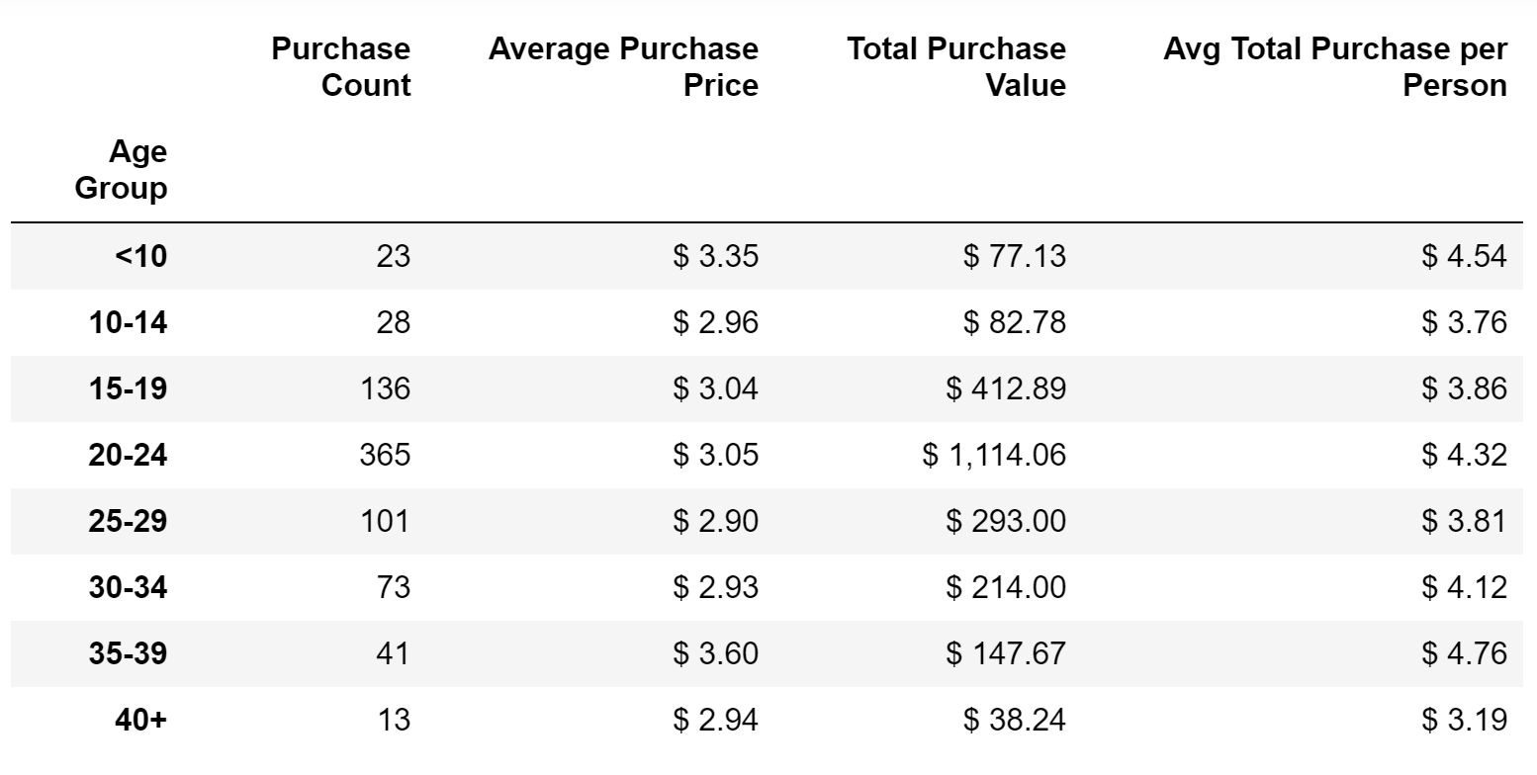
Conclusion 4. From ‘Age Demographics’
According to the analyzed sample, we can conclude that age group between 20 to 24 years old is the biggest spender segment, and it also has the 3rd average spending of age groups, but the ones with bigger average spending per person (<10 and 35-39 years old) are much smaller in absolute purchase value.

Slide 5


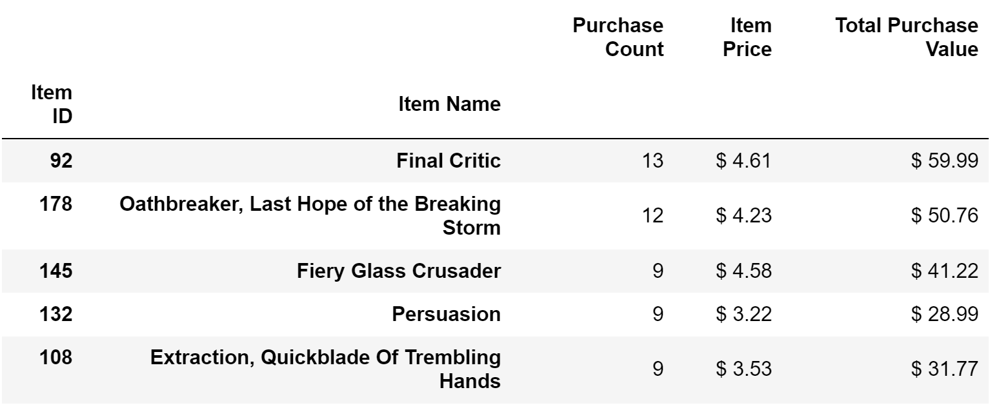
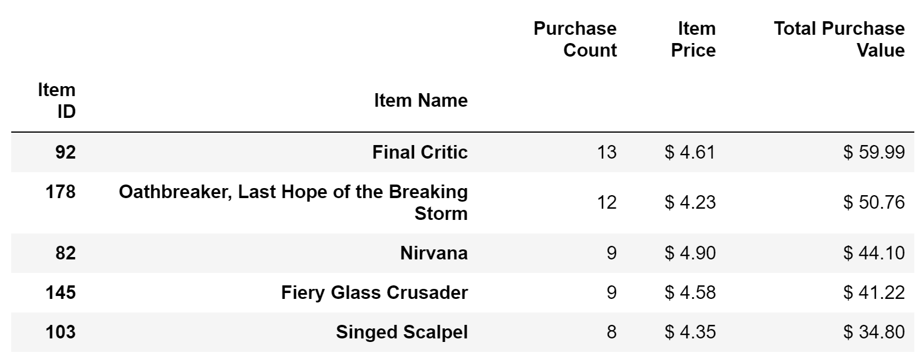
Conclusion 5. From ‘Most Popular’ & ‘Most Profitable Items’
According to analyzed data, there are 2 games that are leaders in both ‘Most profitable’ and ‘Most Popular’ categories:
Final Critic
Oathbreaker, Last Hope of the Breaking Storm
Both games are most sold in number of items and producing biggest revenue

